Slide 1
Doodle Learning at rusper primary school

Slide 2
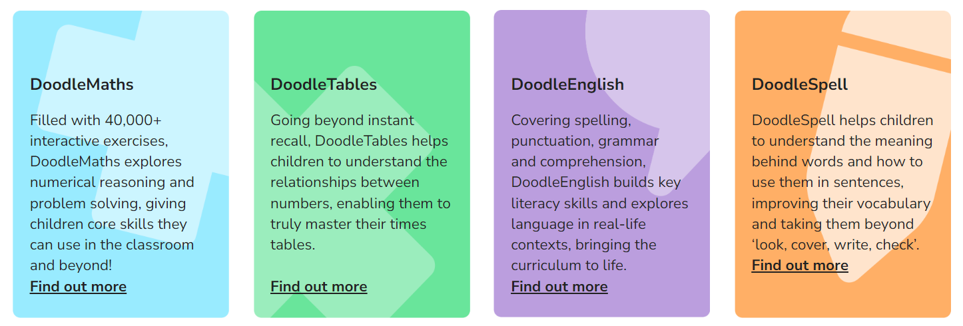
What is doodle Learning?
DoodleLearning is a suite of programmes revolutionising the way children learn!
Covering the core areas of Maths and English, the four apps create every child a personalised learning experience tailored to their needs, helping to boost their confidence and ability.
The four apps are:
DoodleMaths
DoodleEnglish
DoodleSpell
DoodleTimes

Slide 3
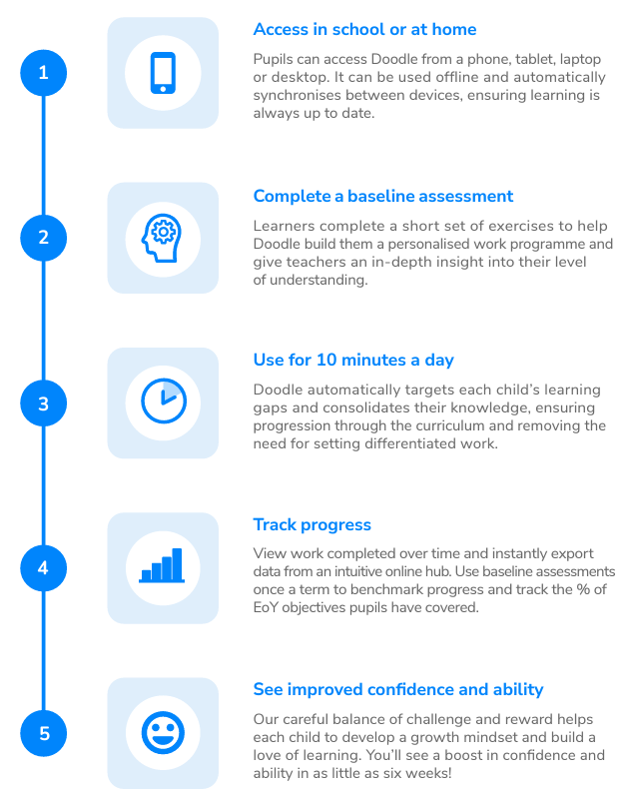
How does it work?
Doodle can be used offline and on tablets, phones, laptops and desktops, letting children learn anytime, anywhere!
And, because Doodle is tailored to each child’s needs, they’re able to complete work independently, making it an ideal homework tool.
Teachers can create custom questions and easily upload their own content, such as spelling lists, for Doodle to transform into fun sets of exercises!

Slide 4
Why doodle learning?
Engaging questions
From measuring angles with a protractor to tracing letters, all of Doodle’s exercises are fully-interactive, ensuring that learning is always fresh and engaging
Interactive explanations
Children learn best by doing; that’s why Doodle’s questions are accompanied by short hands-on summaries rather than lengthy descriptions
A reward system unlike any other
By rewarding effort over ability, Doodle encourages even the least confident and disengaged learners to keep up their hard work
Fun features
With in-app badges, educational games and virtual rewards to enjoy, Doodle encourages daily practice and boosts each child’s confidence a little every day

Slide 5
What others say?
“We have found it particularly useful for children who lack confidence as they can work at their own pace. As it is a personalised resource, all children can make progress independently.”
Liz, Maths Lead, Newbridge Primary School
“Children are becoming independent learners. The fact that Doodle is tailored to each child's ability really works well and gives them confidence to use it by themselves.”
Eva, Year 3 Lead, Brookfield Primary Academy
“The students that use Doodle regularly [have] demonstrated less learning loss over holidays and better retention overall.”
Melanie, headteacher, Coworth Flexlands Prep School

Slide 6
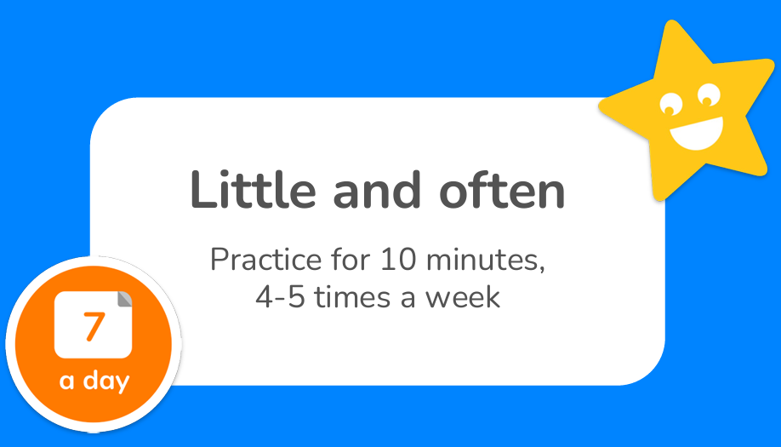
Outcomes – findings from studies using doodle learning
DoodleMaths
Earning 7 stars a day resulted in an average increase of 1.3 DoodleAge a year
Earning 24 stars a day resulted in an average increase of 2.6 DoodleAge a year
The more stars a child earns in DoodleMaths a day, the faster they progress
DoodleEnglish
Daily Doodling really does lead to great things. Earning 5 stars a day resulted in an average DoodleAge increase of 1 year and 8 months across a 12-month period, increasing to 2 years and 3 months when earning 10 stars per day.
Therefore, where DoodleEnglish is used ‘little and often’, academic progression is not only ensured, but also accelerated!

Slide 7
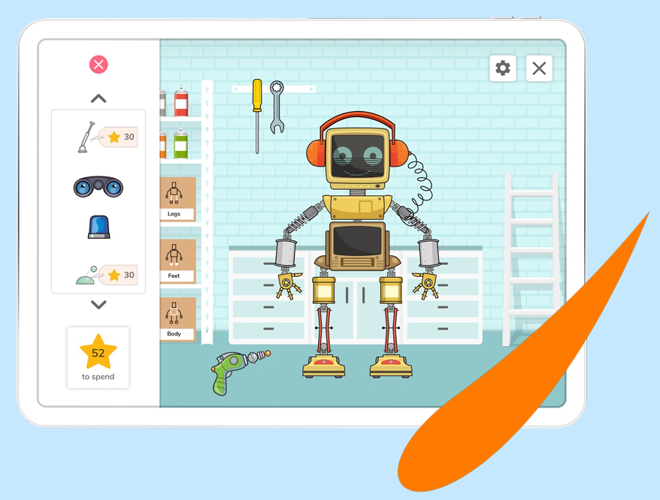
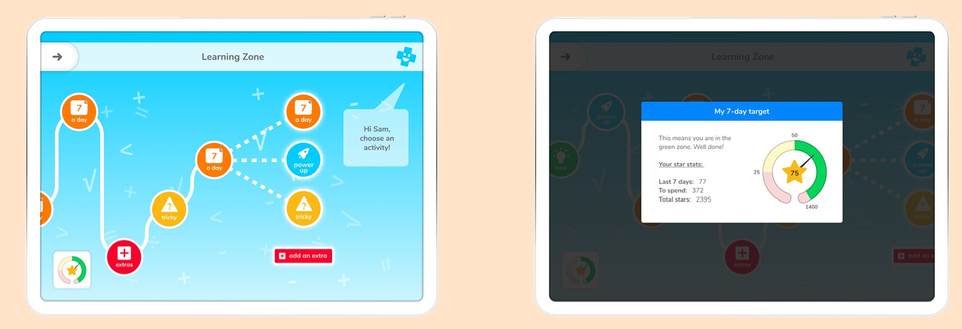
How to use Doodle learning
My Target: To be in the green zone, children must earn their target number of stars per week. When they are in their target zone they are able to access Games, Friends, and your Robot.
Unlock Rewards: Once they’ve reached the green zone, other pages will unlock! Play games and use their hard earned Doodle Stars to buy rewards.
Logging in for the first time
Logging in with a class code
Exploring the features

Slide 8
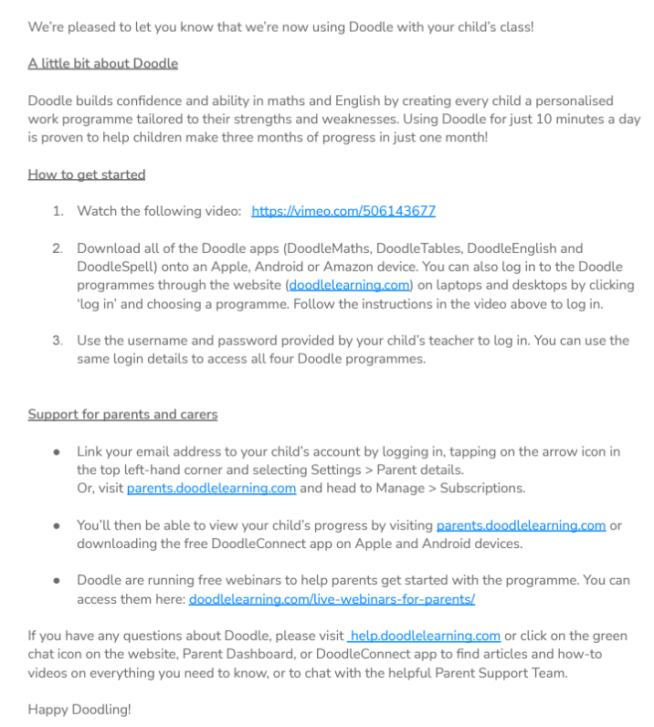
What happens now?
We will introduce DoodleLearning to the children in school where we will explore how to use the new learning apps
Letters will be sent home detailing how to get started and how to log in
All you need to do is download the apps onto a device so your child can start Doodling!
We will regularly monitor progress, including getting feedback from pupils and parents/carers

Slide 9
What will we be expecting?
Ideally we’d like to see children working based on the “Little and often” approach – 10minutes a day on each app for 4-5 times a week
As seen previously, if you aim for this approach, your child will make the most progress across the year
With communication between yourself and your child’s class teacher, you might come to an agreement that your child focuses their attention on one particular app to help plug any learning gaps and help boost confidence

Slide 10
Thank you for listening!
Are there any questions?

